Slide 1


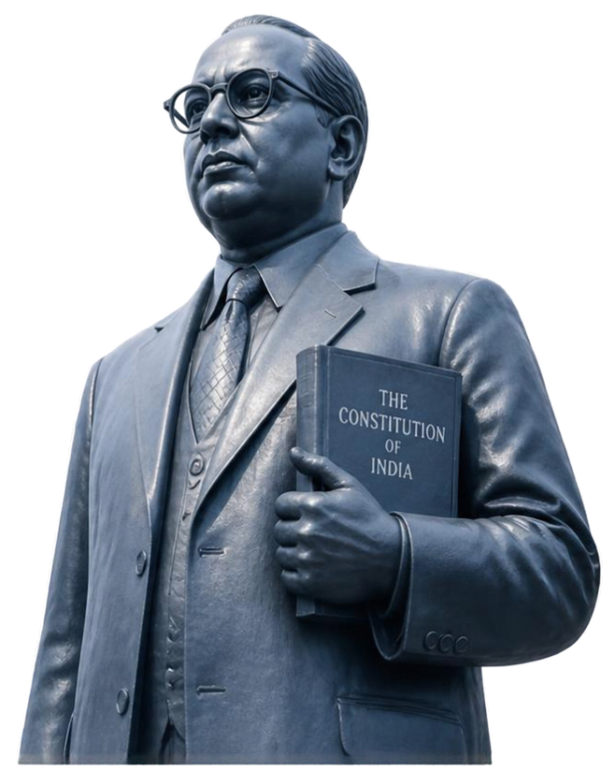
SMART INDIA HACKATHON 2026
DR. B. R. AMBEDKAR DIGITAL HERITAGE ARCHIVE
Preserving legacy. Empowering futures.
Problem Statement ID: 26096
Theme: Smart Education
PS Category: Hardware (with Integrated Software)
Official PS title: [FILL FROM SIH PORTAL]
Team ID: [FILL FROM SIH PORTAL]
Registered team name: [FILL FROM SIH PORTAL]
ONE NATION. ONE ARCHIVE. ONE LEGACY.

Slide 2















PROPOSED SOLUTION
From scattered sources to one trusted digital archive
FROM FRAGMENTED ACCESS
TO A UNIFIED EXPERIENCE
Unify dispersed materials
Bring fragmented archival sources into a single institutional archive
Scattered collections across institutions
Powerful search across all collections
DR. B. R. AMBEDKAR DIGITAL HERITAGE ARCHIVE
Normalize and connect
Source-backed results with citations
Standardized records with citations enable precise search and discovery
Inconsistent formats and descriptions
Timeline view of life, work and impact
Navigate by timeline
Limited discoverability and context
Trace ideas and events through a linked, chronological timeline
Unified. Searchable. Cited. Accessible.
Accessible web and kiosk-style interface
Access for every user
AI-assisted OCR review with an inclusive web and kiosk experience
OUR DIFFERENTIATOR
First-of-its-kind integration of
THREE PRIMARY-SOURCE GROUPS
Personal Documents
Speeches and Writings
Contemporary Media Reports
SMART INDIA HACKATHON 2026

Slide 3
























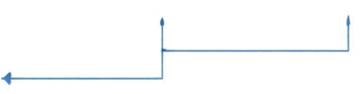



TECHNICAL APPROACH
An end-to-end pipeline for a unified digital heritage archive
CURRENT USERS
Researchers and scholars
SOURCE REPOSITORIES
PROCESSING PIPELINE
APPLICATION AND SERVICES
USER EXPERIENCE LAYER
Scattered collections across institutions
Students and educators
COLLECT
NORMALIZE
VALIDATE
OCR REVIEW
FastAPI Services
Web Archive
Ingest documents, images, audio, video and texts from multiple sources
Standardize formats, structure metadata and ensure consistent descriptions
Verify records, extract metadata and maintain quality control
AI-assisted OCR with human review for accuracy and completeness
APIs for search, retrieval and management
Unified search across all collections
General public
Inconsistent formats and descriptions
PROPOSED HARDWARE
Cited Retrieval
Narrated Timelines
Limited discoverability and context
Source-backed results with citations
Life, work and impact in chronological flow
institutional servers
DATA AND STORAGE LAYER
High-capacity storage
SQL
JSON Records
Metadata
FTSS
Structured archival records
Rich, standardized metadata
Full-text indexing and search
Reliable backup infrastructure
SMART INDIA HACKATHON 2026

Slide 4



















FEASIBILITY AND VIABILITY
A practical path to build and sustain the Dr. B. R. Ambedkar Digital Heritage Archive
RISK TO MITIGATION
TECHNICAL READINESS
FINANCIAL VIABILITY
KEY RISKS
MITIGATION PLAN
Proven open-source technologies and scalable architecture for secure, reliable delivery
Clear cost categories with phased budgeting and sustainable funding approach (estimates pending)
Fragmented and inconsistent source materials
Standardize ingestion, metadata and citation practices
DR. B. R. AMBEDKAR DIGITAL HERITAGE ARCHIVE
Data accuracy and authenticity concerns
Implement verification workflow and source-backed citations
USER & MARKET NEED
OPERATIONAL GOVERNANCE & SUPPORT
Strong relevance for scholars, students and citizens; research and validation in progress (research pending)
Sustained funding
and resource constraints
Adopt phased rollout and multi-source funding approach
Defined roles, policies and support model to ensure long-term trust and continuity
Long-term technology and operations risk
Use open standards, backups and defined governance
SMART INDIA HACKATHON 2026

Slide 5

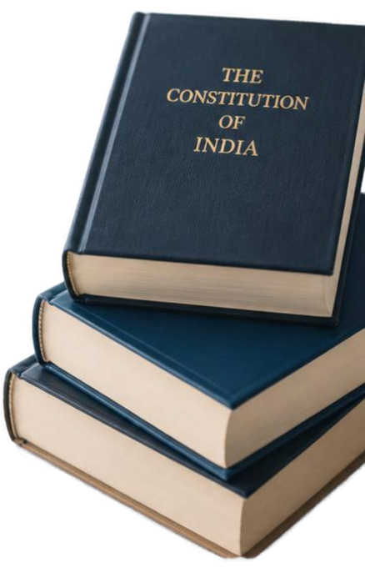












IMPACT AND BENEFITS
Value for every stakeholder, lasting impact for generations
STUDENTS
Easy access to authentic resources for deeper learning
INSTITUTIONAL VISITORS
DR. B. R. AMBEDKAR DIGITAL HERITAGE ARCHIVE
Curated narratives that enrich institutional experience
RESEARCHERS
Reliable, credible sources that enable new insights
PUBLIC
Open access that builds constitutional awareness and civic pride
Preserving legacy, Empowering futures.
ARCHIVISTS
Better tools to organize, preserve, and manage collections
DISCOVERY
PRESERVATION
ACCESSIBLE LEARNING
CONSTITUTIONAL AWARENESS
SMART INDIA HACKATHON 2026

Slide 6

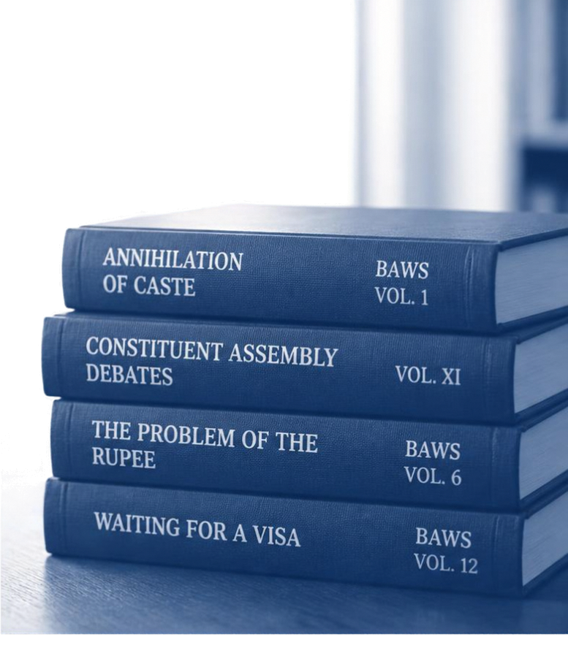








RESEARCH AND REFERENCES
Grounded in primary works and archival records
Annihilation of Caste – BAWS Vol. 1, pp. 23–96
Constituent Assembly Debates – Vol. XI, pp. 972–984
The Problem of the Rupee – BAWS Vol. 6, pp. 315–620
Waiting for a Visa – BAWS Vol. 12, pp. 661–691
SMART INDIA HACKATHON 2026

